Slide 1
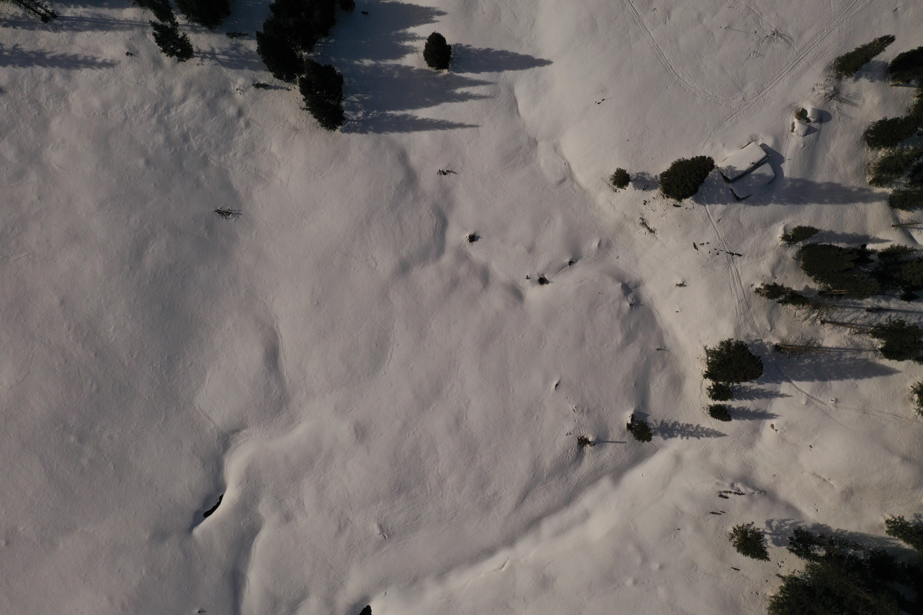
BIOL697: Remote Sensing of Ecological Systems
“Spring” 2022

Slide 2
Introductions

Slide 3
Strategies for Success
Resources:
Read the Syllabus (on Canvas)
Take Charge of Your Own Learning
Manage Your Frustration
Use Your Resources
Chloe
Geospatial Department – Phil Crossley & Micah Russel
Garrett Smith – GIS

Slide 4
Strategies for Remote Learning
Outside time
Remove distraction
Note-taking
Watch recordings at your own pace

Slide 5
The order of the week (and the next 5):
Asynchronous:
Synchronous (Wed. 6:30 - 8pm)
Pre-recorded lecture
Pre-class reading
Comprehension Quiz (due Wednesdays)
Reflection Assignment (due Sundays)
Discussion (45 min)
Break (5 min)
Interactive demo (40 min)

Slide 6
Independent Project (weeks 7-10)
Related to your research!
Manageable
Incorporates concepts from the course
Wanna brainstorm? Shoot me an email.

Slide 7
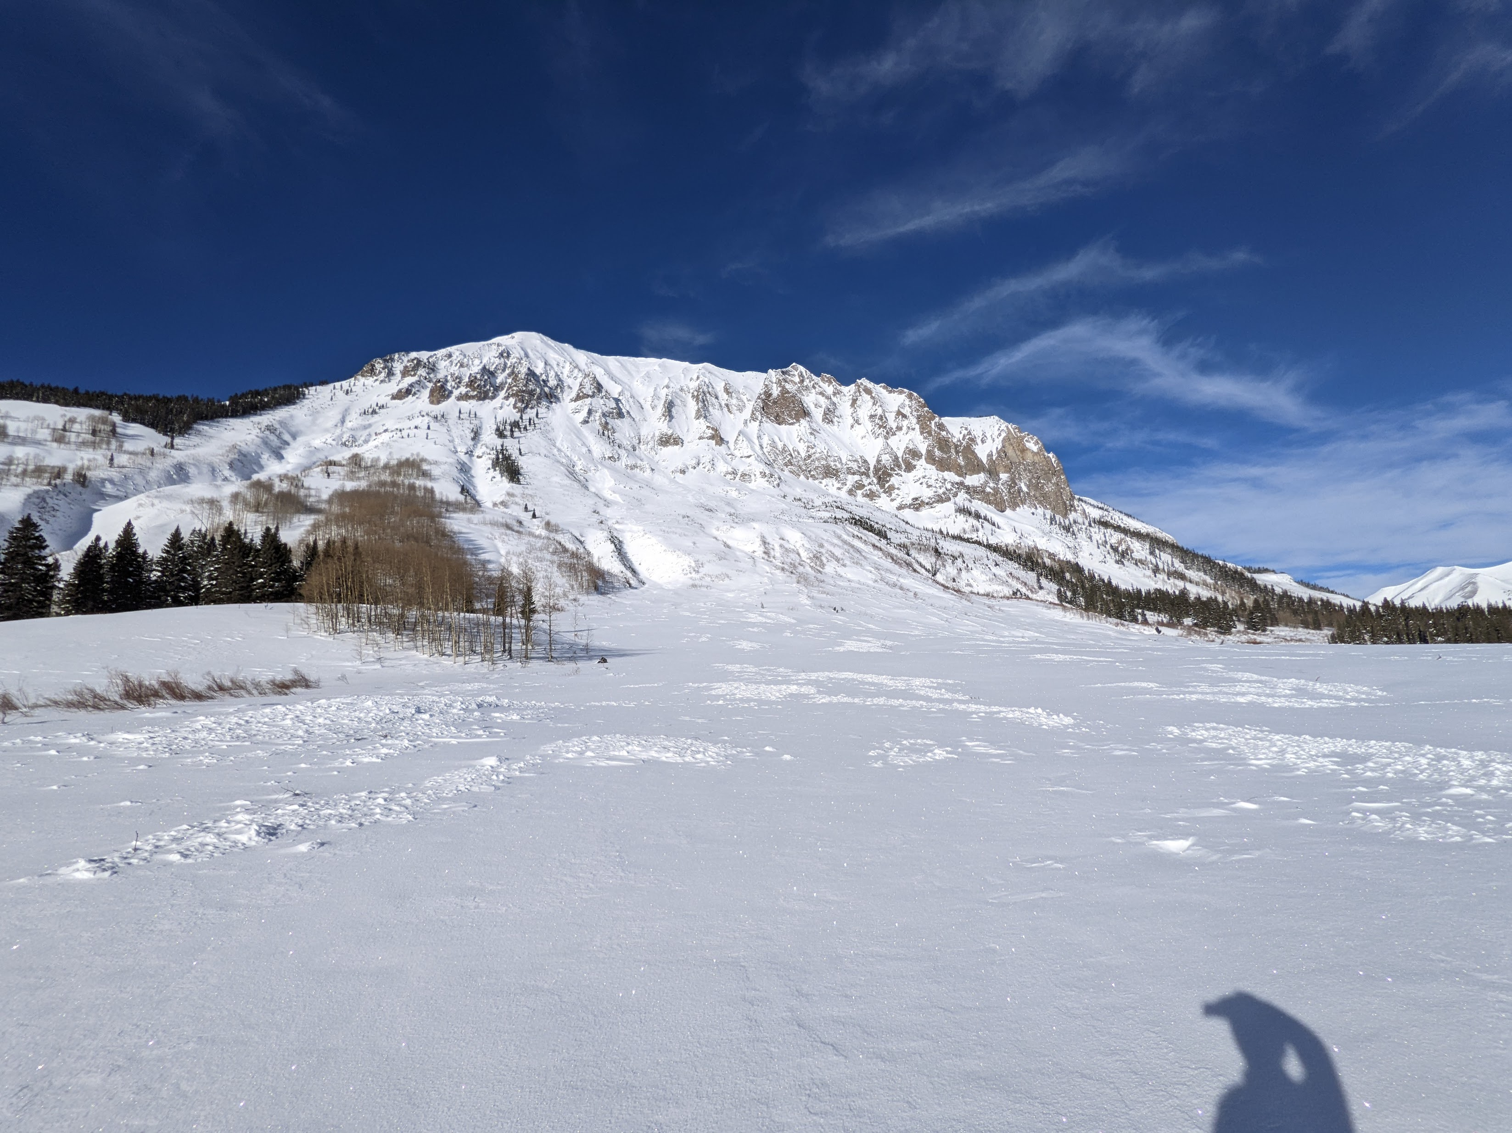
Optional Field Trip to Gothic – Feb. 5th (or 12th)

Slide 8
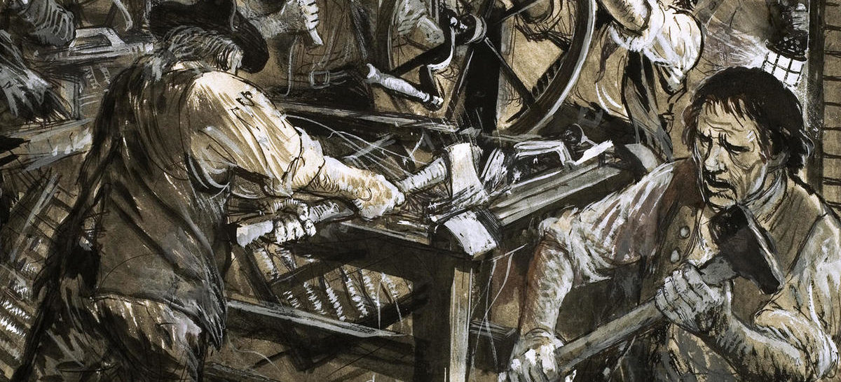
What’s a Luddite?

Slide 9
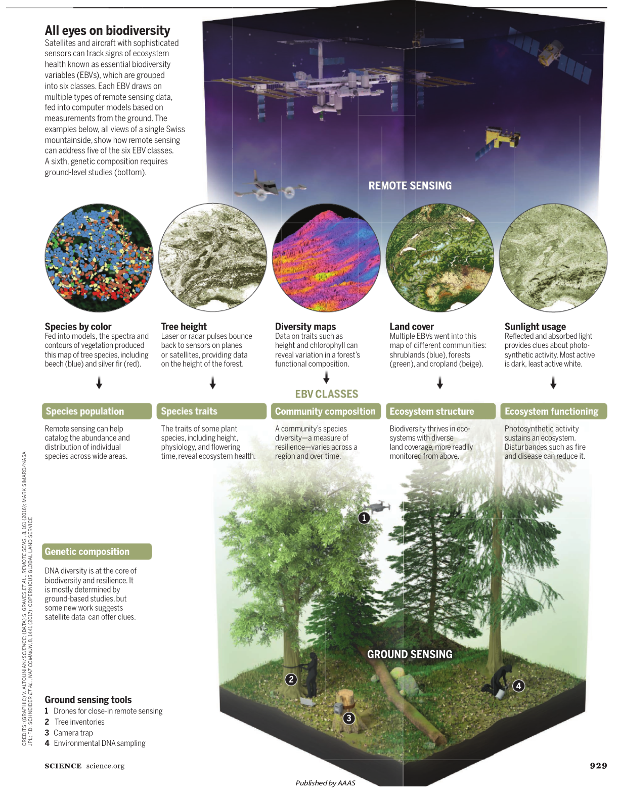
Discussion Questions for Week 1
How is Remote Sensing Changing Ecology, Conservation, and Resource management?
What is the promise?
What is the peril? What outcomes do we want to avoid?
How do we embrace the promise and avoid the peril?

Slide 10
5 Minute Break

Slide 11
Software Demo
Intro to the class GitHub https://github.com/ibreckhe/BIOL697_2022_Spring
Intro to QGIS
Intro to Geospatial R

Slide 12
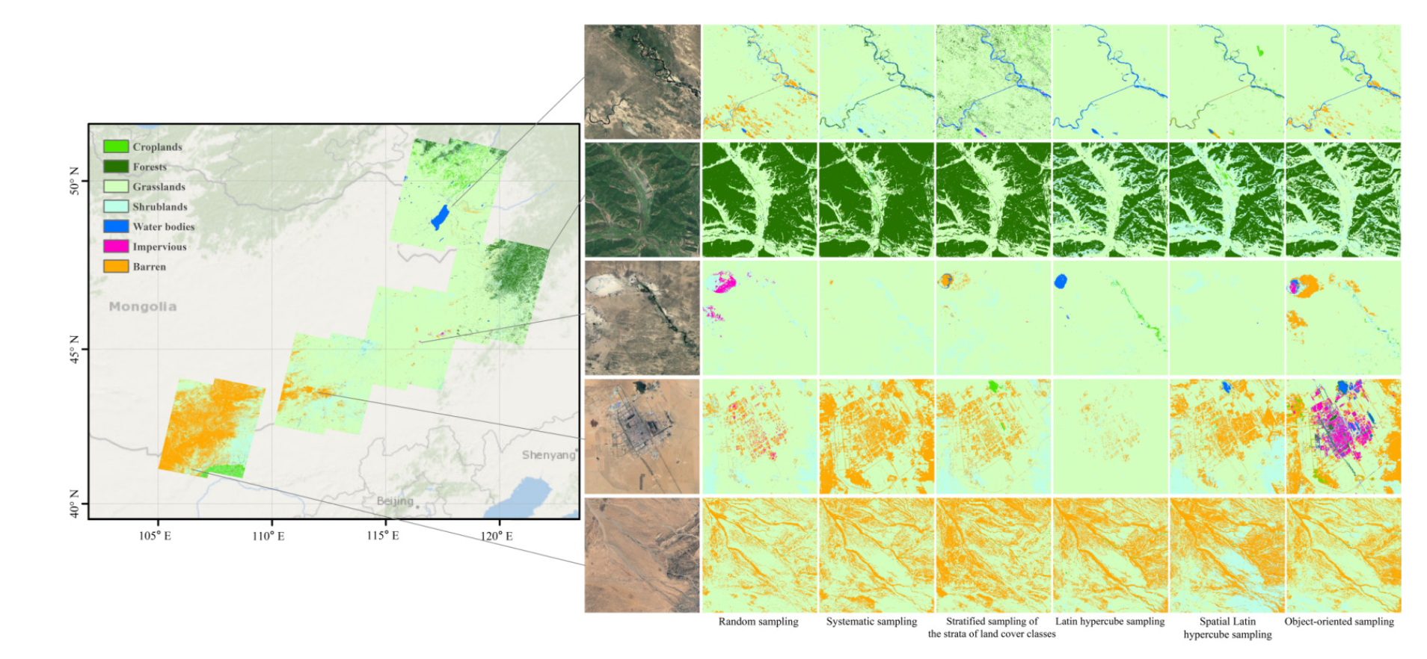
Next Week: Study Design!
Paper: Li et al.
Recorded Lecture
Comprehension Quiz due Wednesday

